Slide 1
8x client
WPF
8x application server ASP.NET Core
SQL server
REST API
8x client
WPF
8x application server ASP.NET Core
SQL server
4x client
VB6
REST API
Other system

Slide 2
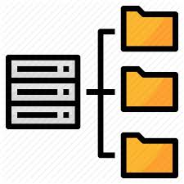
Պատվիրատուի ենթակառուցվածք
ՀԾ-ի ենթակառուցվածք
SQL server
Log server
(Seq)
8x application server
REST API
File storage
Telemetry server

Slide 3

REDIS
Telemetry server
8x application server
File storage
Log server
REST API
Reverse proxy
8x application server
SQL server

Slide 4
4x client
SQL server
ODBC, SQL, TDS
8x client
8x application server
REST API

Slide 5
8x client
8x application server
SQL server
client_extension.cs
REST API
server_extension.cs
Ընդլայնումների պահոց
C# compiler
(Roslyn)
C# compiler
(Roslyn)
client_extension.dll
server_extension.dll
Syscon
Կլիենտի ընդլայնում
client_extension.as
client_extension.cs
Սերվերի ընդլայնում
server_extension.as
server_extension.cs

Slide 6
8x client
8x application server
SQL server
REST API
extension.ui.dll
library1.dll
library2.dll
extension.dll
library.dll
appsettings.json
appsettings.json
"Extensions": [
{
"Id": "EXT",
"Name": "UI extension example",
"Location": “ext",
"MainAssembly": "extension.ui.dll",
"SystemType": "Bank",
"Assemblies": [
"library1.dll",
"library2.dll"
]
}
],
"Extensions": [
{
"Id": "EXT",
"Name": «Server extension example",
"Location": “ext",
"MainAssembly": "extension.dll",
"SystemType": "Bank",
"Assemblies": [
"library.dll“
]
}
],

